Slide 1
TIP project:
Rainbow RL
Society for AI and DL, BITS Goa.

Slide 2


Slide 3
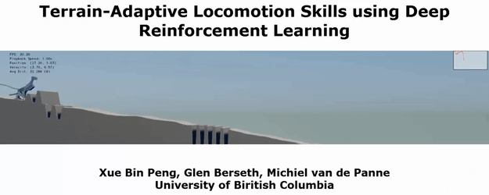
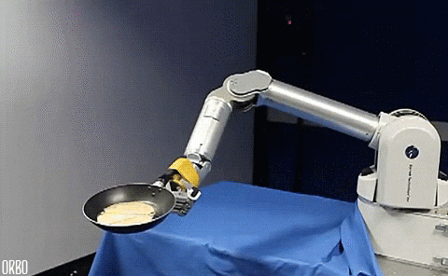
Advancements in Deep RL
Games and Robotics have been the two most widely researched domains in DRL initially, due to the fact that RL is primarily based on mapping human experiences.
Locomotion in a terrain
Pancake Flipper

Slide 4
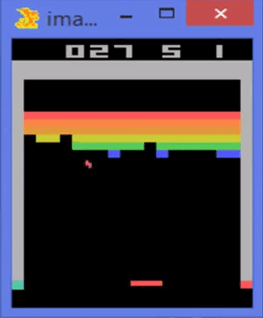
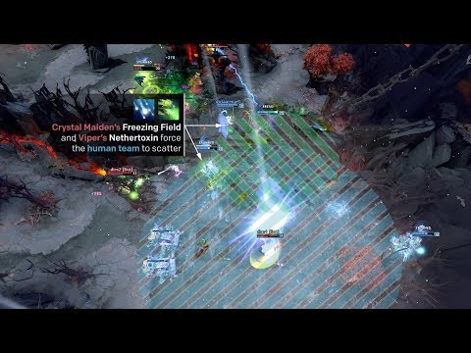
Advancements in Deep RL
DeepMind
Atari Breakout
Open AI Five
Dota 2

Slide 5
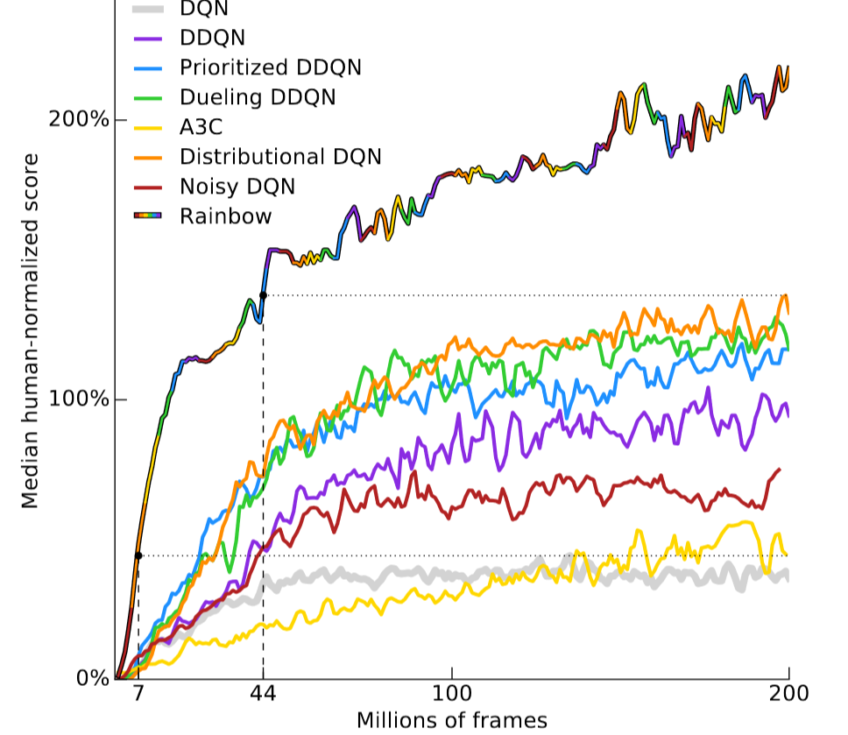
“Rainbow” RL
The Hotel Name
123 Address St
Anytown, ST 12345
Reception immediately following the ceremony
Combining the most popular improvements in RL algos over the years

Slide 6

What will this project not cover?
Library implementations available:
Google Dopamine
DQNs are majorly value based approaches which include both model-based and model-free methods.
As opposed to that, policy gradient based approaches are also quite popular and have been used in OpenAI 5 and continuous control.
We will not focus on policy gradient approaches.
OpenAI baselines
(also check stable baselines)

Slide 7
<Roadmap>
How we’ll go about doing things …
Learning to use Rainbow as black box
It’s very important to be able to reproduce results from other researcher’s code in order to build up on it. You should also try to build an intuition towards hyperparameter tuning.
Implementing DQN from scratch
Code DQN in scalable, modular and object oriented way. Compare performance with benchmarks.
Understanding and implementing each of the variants one by one
Figure out the motivation behind each of 6 variants, implement a variant in groups and compare.

Slide 8
Prerequisites
Comfortable with Python and can learn from reading other people’s code.
Experience with neural networks is a big plus!
Deeply motivated as reading RL papers could be tedious at first sight.

Slide 9
Mentors for the project
Sharad Chitlangia
Rijul Ganguly
Sauradeep Chakraborty
Pranav Mahajan
Ajay Subramaniam
Learning resources:
Deep RL nanodegree (DC nick: bhishma_pitamah)
Sutton and Barto book
David Silver lectures

Slide 10
http://saidl.in
See you soon!

